Slide 1



GESTURE RECOGNITION SYSTEM
Unlock technology with a wave of your hand.

Slide 2

AGENDA
What is Gesture
1
Gesture recognition system
4
Introduction of Gesture Recognition
2
Usecase
5
Types of Gesture Recognition
Challenges
6
3
1

Slide 3
WHAT ARE GESTURES?
Gastures are an important aspect of human interaction, both independently and in the context of man-machine interfaces.
Gesticulation
Semiotic
Language-like Gestures
TYPES & ROLE OF GESTURES
Ergotic
Emblems
Sign languages
Epistemic
2

Slide 4
INTRODUCTION OF GESTURE RECOGNITION
Gesture recognition is a language technology with the goal of interpreting human gestures via mathematical algorithms. Gesture can originate from any bodily motion or state but commonly originate from the face or hand.
Gesture recognition enables human to interface with the machine and interact naturally without any mechanical devices. Using the concept of gesture recognition, it is possible to point a figure at the computer screen so that the cursor will move accordingly.
3

Slide 5
TYPES OF GESTURE RECOGNITION
1
2
3
4
5
6
SIGN-LANGUAGE RECOGNITION
FACIAL EXPRESSION
FACE RECOGNITION
ELECTRICAL FEILD SENSING
VISION
BASED TECHNO-LOGIES
DEVICE GESTURE TECH-NOLOGIES
4

Slide 6
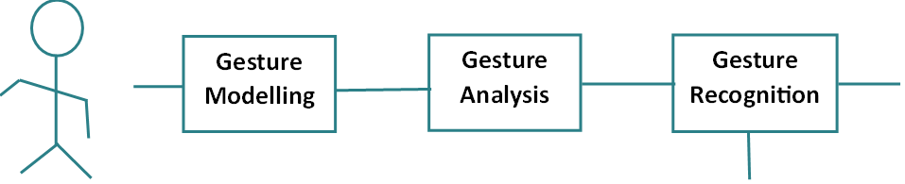
GESTURE RECOGNITION SYSTEM
Feature space representation
Recognized gestures
Gesture DB
5

Slide 7

BASIC WORKING OF GESTURE RECOGNITION
The scope of a gesture interfaces for human-computer interactions is divided into 3 parts:
MODELING
ANALYSIS
RECOGNITION
Temporal Modeling
Spatial Modeling
3D hand arm modeling
Appearance-based Modeling
Feature Detection
Parameter Estimation
Optimal partitioning of the parameter space
Implementation
Computational Efficiency
6

Slide 8
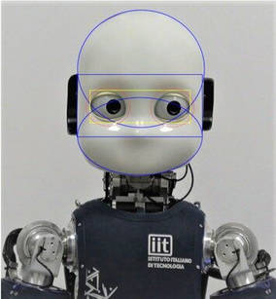

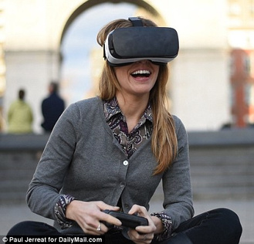
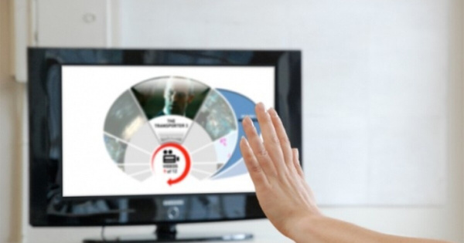

USECASE
1
2
3
4
5
Social assistive robotics
Sign language recognition
Virtual controllers
Remote Control
Control through facial gestures
7

Slide 9
CHALLENGES
LATENCY
LACK OF GESTURE LANGUAGE
unacceptable applications
Difficulty in indentification
ROBURSTNESS
PERFORMANCE
Insufficiency in background
Accurately working measurement
8

Slide 10
THANK YOU!
Any questions, or suggestions?

